Slide 1
Lecture 10 Simulation Using Excel Part 1

Slide 2
Introduction
Simulation is the process of designing a model of a real system and conducting experiments with this model for the purpose either of understanding the behavior of the system or of evaluating various strategies for the operation of the system.
You can find simulation used in everything from economics to nuclear physics to regulating the flow of traffic.

Slide 3
Simulation as a Performance Assessment Tool
System
Experiment
with the
actual system
Experiment
with a model
of the system
Physical
model
Mathematical
model
Analytical
model
Mathematical
Simulation

Slide 4

Simulation Approach
A model that mimics the behavior of a (stochastic) system
Make a decision, x
Random event, r
Outcome, f(x,r)
Today
Future date
Time
(2) Simulate n
Random events
(Data Table or
Copy the model
n times)
Probabilistic Input
(random number)
(3) Compute n
simulated outcomes f(x,r_{i})
i=1,2,…,n
Choose x
(decision variable)
r₁, r₂, …, r_{n}
(4) Evaluate
Expected outcomes
Controllable
Input
Model
Outcome
(5) If E[f(x,r)] is not a satisfactory result,
then go to (1) and repeat for another value of x

Slide 5

Monte Carlo Simulation
Monte Carlo simulation is a computational technique that involves a sequential evaluation of the outputs of a deterministic model, using sets of random numbers as inputs. To simulate the inputs, a computer generates the random inputs by sampling from probability distributions.
This method is named after Monte Carlo, Monaco, where the primary casino attractions are games of chance such as roulette wheels, dice, and slot machines. These games all exhibit random behavior.

Slide 6
Applications
Non-Business applications
Flight simulator
Aircraft design
War games in military
Business applications
Security pricing (bond, asset, risk management)
Queuing simulation (traffic control, Disneyland)
Factory analysis and design
Enterprise management, supply chain management

Slide 7
Example: Art’s Newsstand
At his newsstand, Art sells the daily newspaper. He cannot foretell the number D (uniformly distributed between 30 and150) of papers he can sell in any given day.
Before Art’s customers appear, however, he must purchase his newspapers from the wholesaler at $0.30 apiece.
For each paper Art sells, he receives $0.50, its retail value. For each paper Art does not sell, he receives $0.02, its scrap value.
Art wants to maximize his average profit. How many newspapers should he order every day?

Slide 8

The Rule of Averages

Slide 9
Art’s Newsstand
Decision Variable: q=quantity of newspapers purchased every day
Art’s Profit:
If D≥q then Art makes 0.5×q-0.3×q
If D<q then Art makes 0.5×D+0.02×(q-D)-0.3×q
Combining the two expressions yields:
0.5×min(q,D)+0.02×max(q-D,0)-0.3×q
Revenue
Scrap value, if any
Purchase cost

Slide 10
Art’s Newsstand
Therefore given demand, D, and an order quantity, q, Art’s profit is
0.5×min(q,D)+0.02×max(q-D,0)-0.3×q.
We are told that Art wants to maximize his average profit.

Slide 11
Art’s Newsstand
Hence Art’s objective is find an order quantity, q,
optimal in
max E[0.5×min(q,D)+0.02×max(q-D,0)-0.3×q].
This appears more complicated than any of the problems we have seen thus far!
What do we do?
Expected Profit

Slide 12
Art’s Newsstand
An Idea: Why not observe the demand Art’s newsstand experiences on several successive days?
Then we can find an ex-post order quantity, q, that would have maximized Art’s average profit during the same period.
Then Art can start ordering this quantity in the future!

Slide 13
Art’s Newsstand
Another idea: Since observing Art’s demand each and every day takes time, why not let computer generate these observations for us?
We know that demand is uniformly distributed between 30 and 150 papers every day. That is enough information for Excel spreadsheet to generate these observations for us.
THIS TECHNIQUE IS REFERRED TO AS SIMULATION

Slide 14
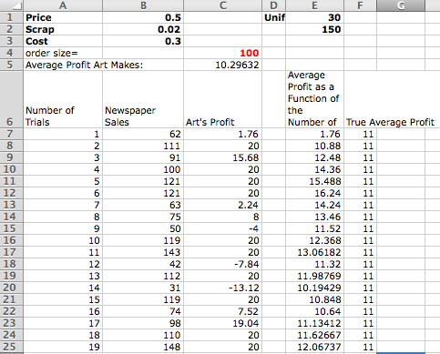
Art’s Newsstand: Spreadsheet
Cell C7: Art’s Profit=0.5*MIN($C$4,B7)+0.02*MAX(0,$C$4-B7)-0.3*$C$4
Estimate of an Average Profit=AVERAGE ($C$7:C11)
An average value of all profit values in Col C
Column B: Simulated Demand=RANDBETWEEN(30,150)

Slide 15
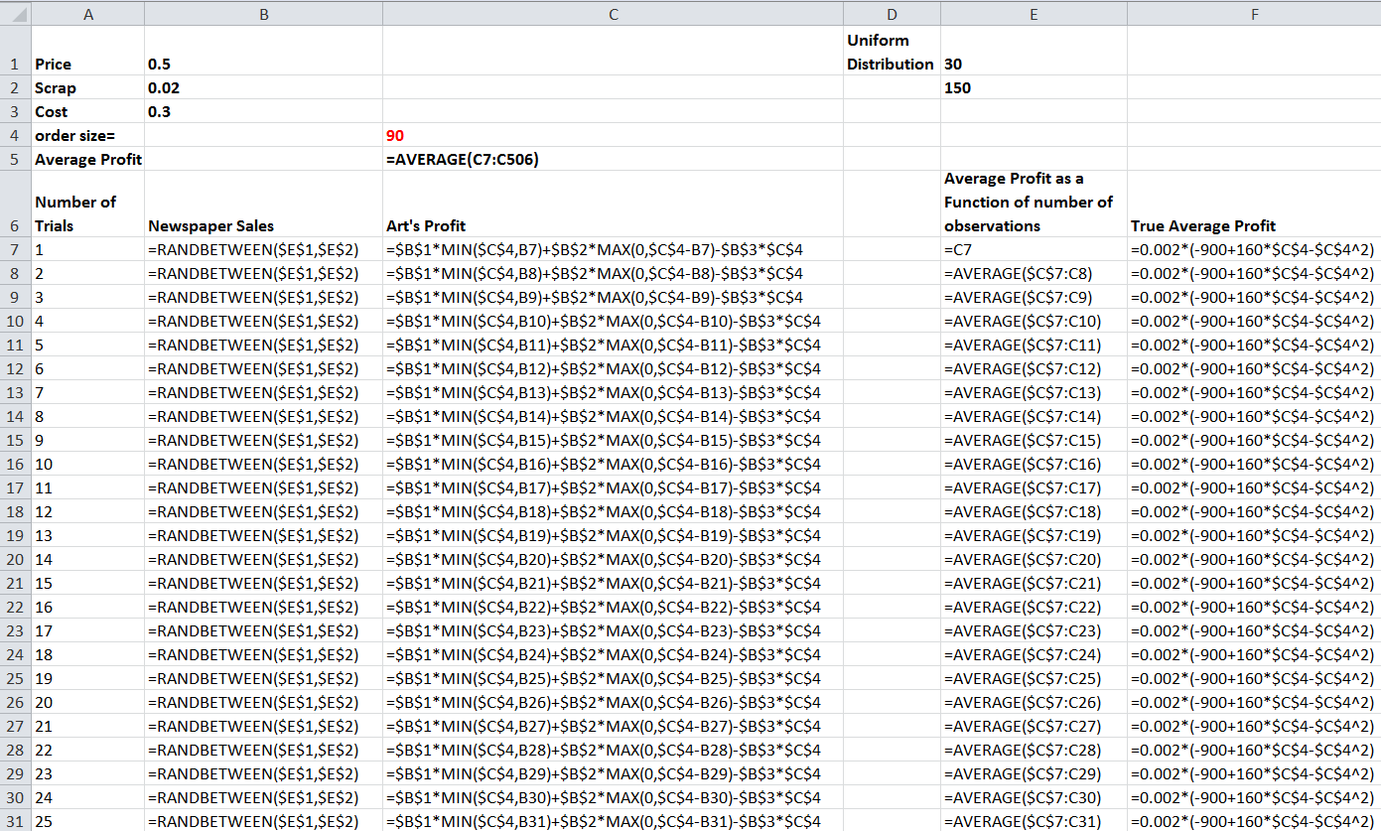
Art’s Newsstand: Formula Sheet

Slide 16
Art’s Newsstand

Slide 17
Plan
Simulation as a performance assessment tool
Random number generation
Simulating values from a given probability distribution
Applications of simulation
Some statistical background: putting confidence intervals around our results
Using Excel’s Scenario Manager to include decisions
Limitations of Monte Carlo simulation
Part 1
Part 2

Slide 18
Simulation
Key element is randomness
Assume that some inputs are random variables
Modeling randomness by generating random variables from their probability distributions
Simulation modeling process
Develop the basic model that “behaves like” the real problem, with a special consideration of the random or probabilistic input variables
Conduct a series of computer runs (called trials) to learn the behavior of the simulation model
Compute the summary (output) statistics and make inferences about the real problem

Slide 19

Random Number Generation
The most fundamental random number generated by a computer is a value that is chosen from the range [0,1) ( i.e., greater than or equal to zero and less than 1) with equal likelihood.
You can generate a random number from this distribution in Excel:
=RAND ()
Note: The computer uses a pseudorandom number generator (PRNG). A PNRG is an algorithm for generating a sequence of numbers that approximates the properties of random numbers. The sequence is not truly random in that it is completely determined by a relatively small set of initial values, called the PRNG's state. It repeats itself after 2³¹ -1 = 2,147,483,647 trials. For most practical applications, this is not an issue to be concerned about.

Slide 20
Simulating Values from Probability Distributions
Using Excel, it is easy to generate random numbers chosen from the range [0,1) with equal likelihood (=RAND())
This, however, is often insufficient
Common probability distributions used in simulations
Uniform distributions
Bernoulli distributions
Binomial distributions
Normal distributions
Exponential distributions
Discrete general distribution with n outcomes

Slide 21
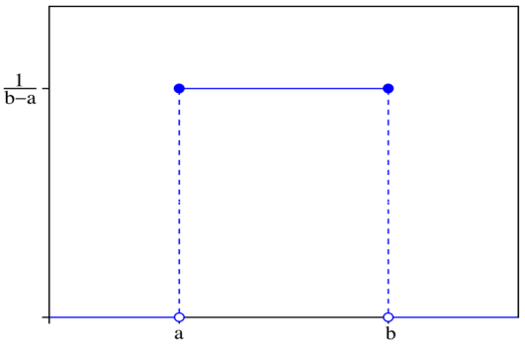
Continuous Uniform Distribution
Continuous Uniform Distribution: A variable follows a continuous uniform distribution between a lower limit a and an upper limit b if all values between a and b (including fractional values) are equally likely. To simulate a variable that follows this distribution, we use the following formula:
For example, =3+(9-3)*RAND() will generate random real numbers between 3 and 9

Slide 22
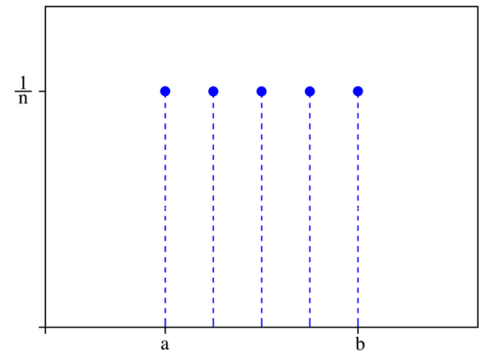
Discrete Uniform Distributions
Discrete Uniform Distribution: If all values between a lower limit a and a upper limit b are equally likely, but the variable is allowed to take on only integer values. The formula is:
For example, if we want integers between 0 and 99, we use =RANDBETWEEN(0,99)

Slide 23
Bernoulli Distribution
Bernoulli Distribution has 2 outcomes: outcome A with probability p, and outcome B with probability 1-p. To simulate a variable that follows this distribution , we use the IF function:
Suppose we want to randomly select individuals from a population where there are 55% males and 45% females. In the long term, the selected group has exactly 55% males and 45% females. In the short term, any combination of males and females is possible. To simulate these random draws in Excel, we use :
IF(RAND()<p, A, B)
p 1-p
A B
IF(RAND()<0.55,”Male”,”Female”)

Slide 24
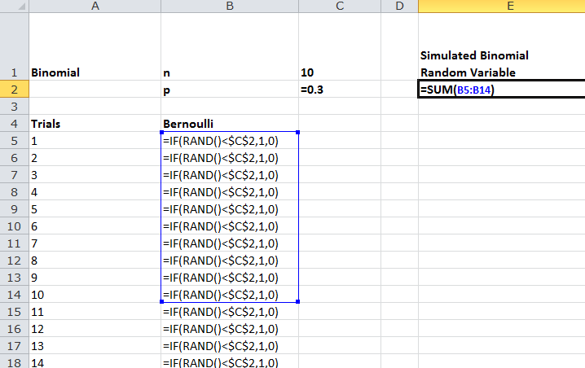
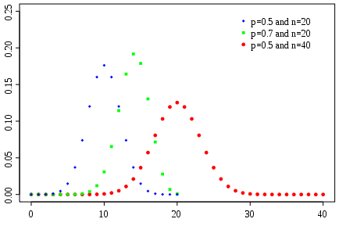
Binomial Distribution:
Binomial Distribution (n,p) counts number of outcome A in n-independent Bernoulli trials, where the probability of outcome A in each trial is p, and the probability of outcome B is 1-p.
Binomial Distribution Parameters: n,p
Multiple (>n) independent
Bernoulli trials

Slide 25
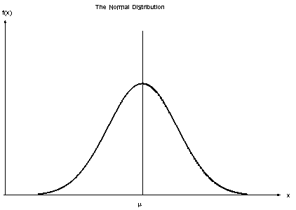
Normal Distribution
Normal Distribution: To simulate random numbers from a normal distribution with mean μ and standard deviation σ, we use the NORMINV function as follows:
For example =NORMINV(RAND(), 30,5) will generate a random number from a normal distribution with a mean of 30 and
a standard deviation of 5.

Slide 26
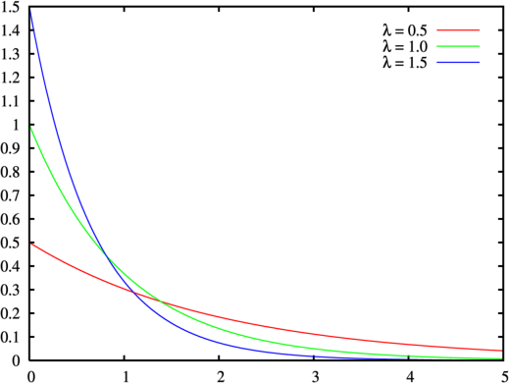
Exponential Distribution
Exponential Distribution: Commonly used to simulate interarrival and service times in queuing systems. The exponential distribution is described by a single parameter, μ, which describes the average rate of occurrences (1/μ describes mean time between successive occurrences). To simulate a random value from an exponential distribution, we use:
μ=

Slide 27
Exponential Distribution
Exponential Distribution (continued): For example, if the average service rate in a queuing system is 10 customers per hour, the service time (in hours) for a specific customer may be randomly generated by using the following formula:

Slide 28
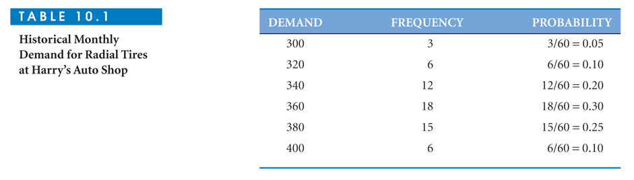
Discrete General Distribution with n outcomes (n>2)
Discrete General Distribution with n Outcomes: Demand for tires observed at Harry’s Auto Shop is one of six values:
We want to simulate demands randomly from this distribution

Slide 29
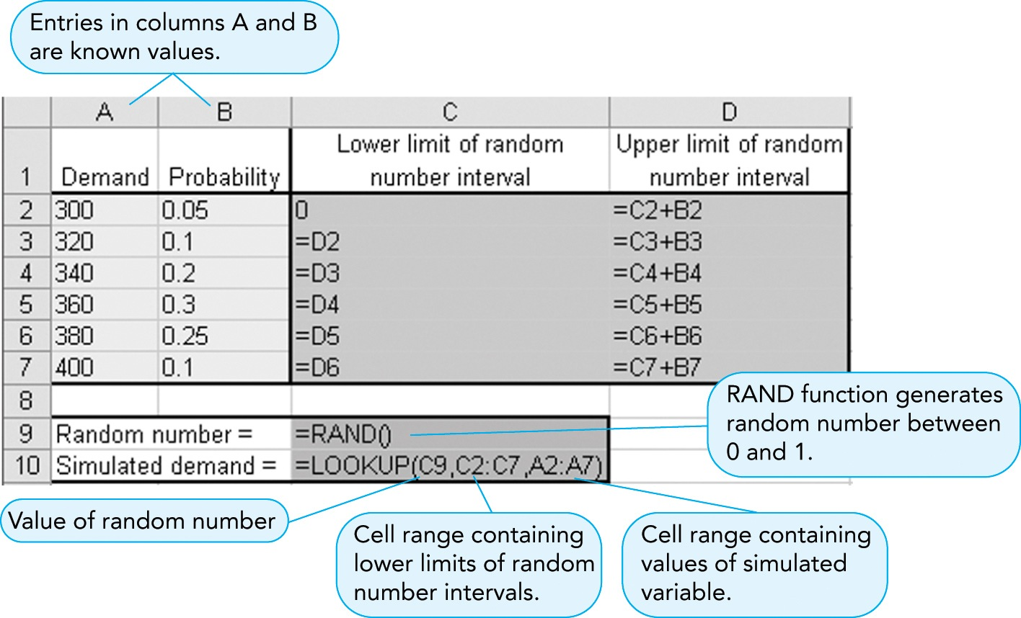
Discrete General Distribution
A convenient tool for this is the Excel LOOKUP function
Lower limit | Upper limit
0 | 0.05
0.05 | 0.15
0.15 | 0.35
0.35 | 0.65
0.65 | 0.90
0.90 | 1.0
0.05 0.15 0.35 0.65 0.90
0.05 0.10 0.20 0.30 0.25 0.10
1
0
300 320 340 360 380 400

Slide 30
Syntax of Lookup Function
LOOKUP(lookup_value, Range 1, Range 2)
Look in Range 1 for the lookup_value and return a value from the same
position in Range 2)
Remark:
1. The values in Range 1 must be placed in ascending order
2. If the LOOKUP function can't find the lookup_value, the function matches
the largest value in Range 1 that is less than or equal to lookup_value.

Slide 31
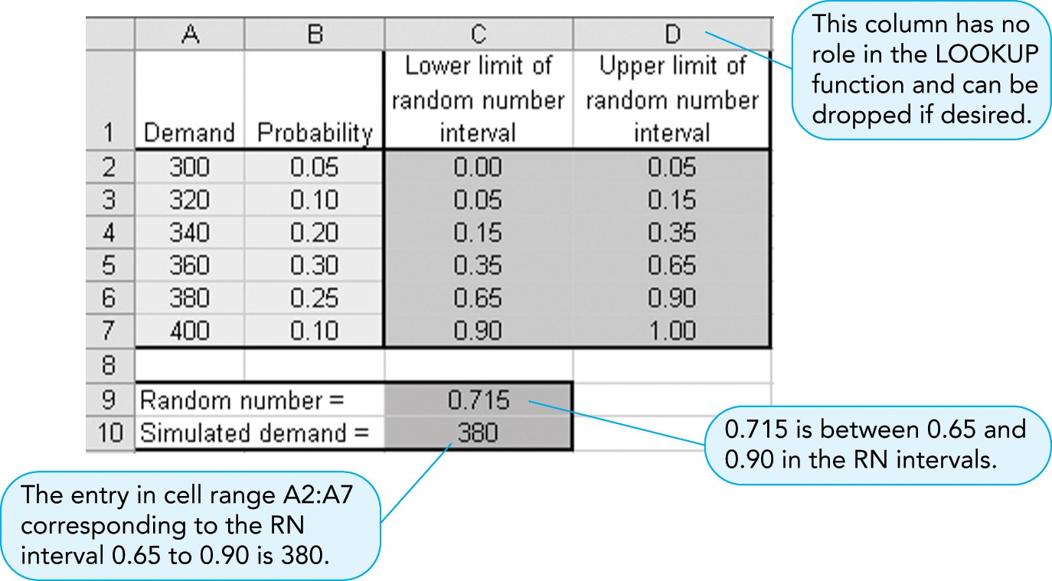
Discrete General Distribution
Using the Excel LOOKUP function:
0.05 0.15 0.35 0.65 0.90
0.05 0.10 0.20 0.30 0.25 0.10
1
0
300 320 340 360 380 400

Slide 32
Simulate Probability Distributions (Excel)
To SIMULATE | USE BULT-IN EXCEL FORMULA
Random number between 0 and 0.9999… | =RAND()
Continuous uniform distribution Between a and b | =a+(b-a)*RAND()
Discrete uniform distribution Between a and b | =INT(a+(b-a+1)*RAND ()) or =RANDBETWEEN(a,b)
Normal distribution Mean=μ; Standard deviation=σ | =NORMINV(RAND(), μ, σ)
Exponential distribution Mean rate=μ | =−(1/μ) *Ln(RAND())
Bernoulli distribution: Two outcomes: A and B, probability of A=p | =If(RAND()<p, A,B)
Binomial distribution: Sample size n, probability p | Sum up n independent Bernoulli trials. See Slide #24
Discrete general distribution: Range 1=Cell range containing lower limits of the random number intervals Range 2 = Cell range containing the variable values | =Lookup(RAND(), Range 1, Range 2)

